Slide 1
Unit 1 Basics of Operating System
Total Hour:6 Hrs
Presented by
Er.Harendra Bikram Shah (Lecturer)
Department of BCA NAST

Slide 2
OUTLINES
1.1 Introduction, goals of operating system
1.2 Operating-System Structures and functions
1.3 Types of Operating Systems
Batch Processing
Multiprogramming
Multiprocessing
Networking
Real Time (RTOS)
Distributed
Embedded system
1.4 Kernel Data Structures, System Interface, System Calls
1.5 Virtual Machine

Slide 3
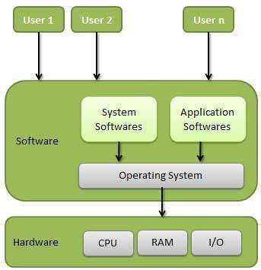
Introduction to OS
Intermediary between the user of a computer and computer hardware.
System software that manages and controls computer hardware.

Slide 4
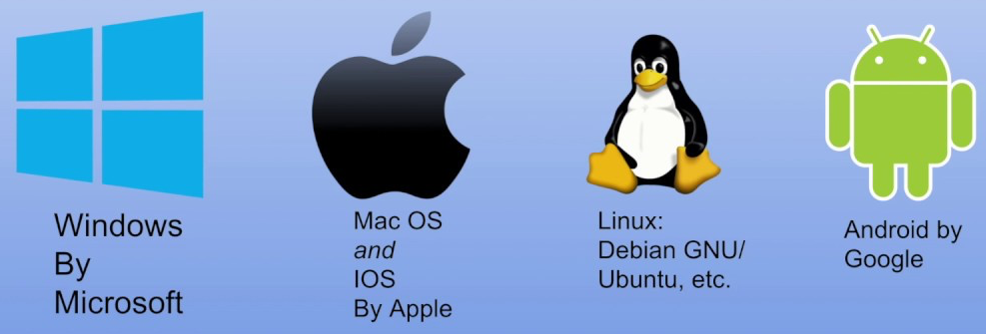
Examples of OS

Slide 5
History of OS
Generation | Time Period | Key Features | Examples
First Generation | 1940s - Early 1950s | - No operating systems - Manual programming | ENIAC (No OS)
Second Generation | 1950s - Early 1960s | -Simple batch processing - Introduction of punch cards | - IBM 7094 (Batch Processing)
Third Generation | 1960s - Early 1970s | - Multiprogramming - Time-sharing systems | - IBM OS/360 - UNIVAC
Fourth Generation | 1970s - 1980s | - GUI-based operating systems - Introduction of Unix | - MS-DOS - Unix
Fifth Generation | 1980s - 1990s | - Advanced multitasking - Early mobile operating systems | - Windows 95 - Mac OS
Sixth Generation | 1990s - 2000s | - Start of modern mobile OS - Open-source OS emerges | - Linux - Windows NT
Seventh Generation | 2000s - Present | Cloud computing - Mobile-first OS - Virtualization - Integration of AI and machine learning | - Windows 10 - macOS - Android - iOS

Slide 6
Operating-System Structures/Architecture
Simple/Monolithic Structure
Micro-Kernel Structure
Hybrid-Kernel Structure
Exo-Kernel Structure
Layered Structure
Modular Structure
Client-Server Model Structre
Virtual Machines Structre

Slide 7
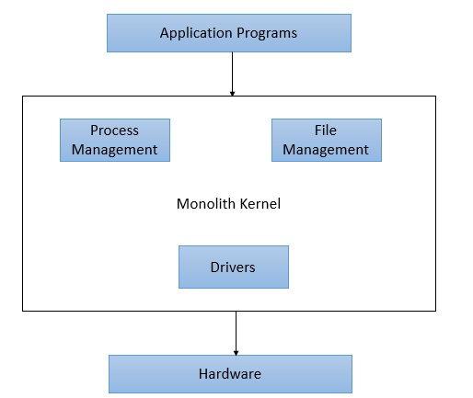
1. Simple/Monolithic Kernel
In this structure, all operating system components reside in a single, large kernel.
same memory space is used to implement user services and kernel services.
Advantages:
Efficient communication between components
Simple to implement
Disadvantages:
Difficult to maintain and modify
Less secure (a single bug can compromise the entire system)
Examples: Unix, Linux (early versions),MS-DOS

Slide 8
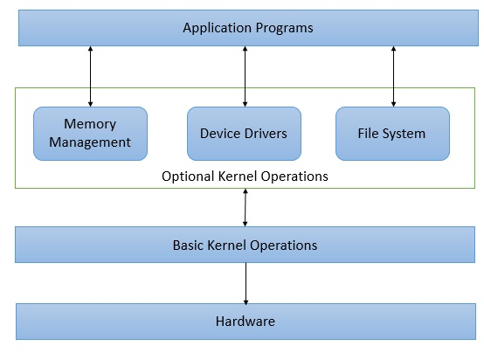
2. Micro-Kernel Structure
Here multiple kernels each one specilized in particular service and developed independent to the other one with small size
Advantages
Reliable and Stable
Maintainability
Disadvanatges
Complex to Design
Performance Degradation
Examples: macOS

Slide 9
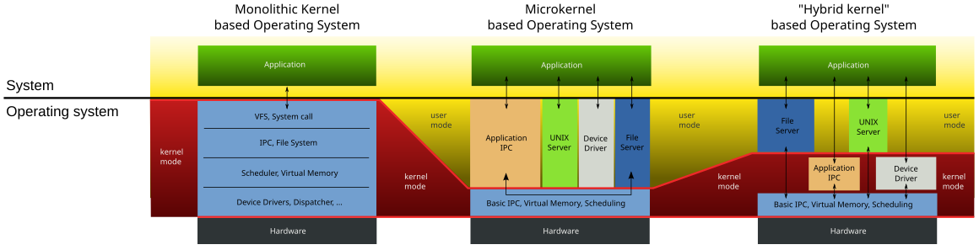
3. Hybrid Kernel Structure
This combines elements of both monolithic and microkernel structures.
Some components are integrated into the kernel, while others run as separate processes.
Advantages:
It offers good performance
It enhances overall system reliability by cooping both Kernels.
Disadvantages:
It increases overall complexity of system by implementing both structure.
It increases time complexity and decreases performance.

Slide 10
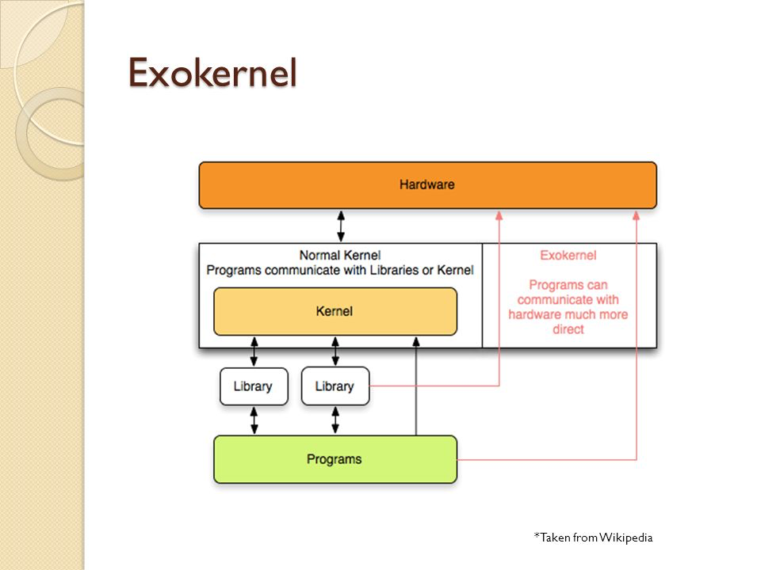
4. Exo-Kernel Structure
An exokernel allows to directly manage hardware resources by application software
whose aims to maximize performance and flexibility.
Advantages:
Very high performance
Maximum flexibility for applications
Disadvantages:
Complex and difficult to implement
Requires significant application-level support
Examples: Exokernel (developed at MIT), Nemesis OS

Slide 11
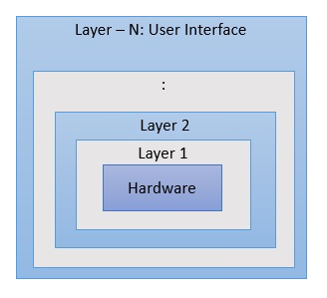
5. Layered Structure
Divided into layers, where each layer performs a set of functions and provides services to the layer above it.
The bottom layer is usually hardware, and the highest layer is the user interface.
Advantages:
Easier to debug and maintain
Can develop or change layers independently.
Disadvantages:
Layering can add overhead, which might impact performance.
Strict hierarchical structure might make some interactions between layers difficult.
Examples: UNIX, Linux.

Slide 12
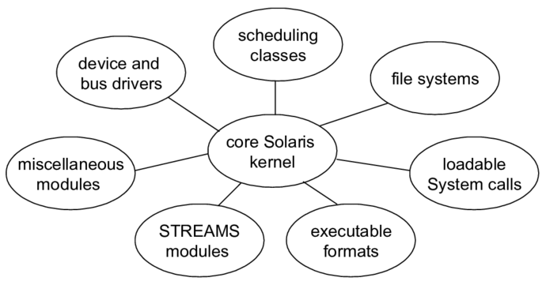
6. Modular Structure
Improved form of Monolithic kernel that allows for dynamic loading and unloading of kernel modules, enabling customization and flexibility.
Advantages:
Customizable and flexible
Easier to maintain and extend
Disadvantages:
Can introduce performance overhead
Complex designing
Examples: Linux, Windows NT

Slide 13
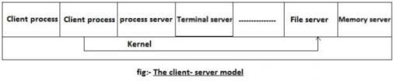
7. Client-Server Model Structure
In this structure, the OS is split into multiple services that communicate over a network.
A client requests services, and a server responds and often used in distributed systems.
Advantages:
Good for distributed systems
Scalable and flexible.
Disadvantages:
Network latency
security issues
Examples: Distributed OS.

Slide 14
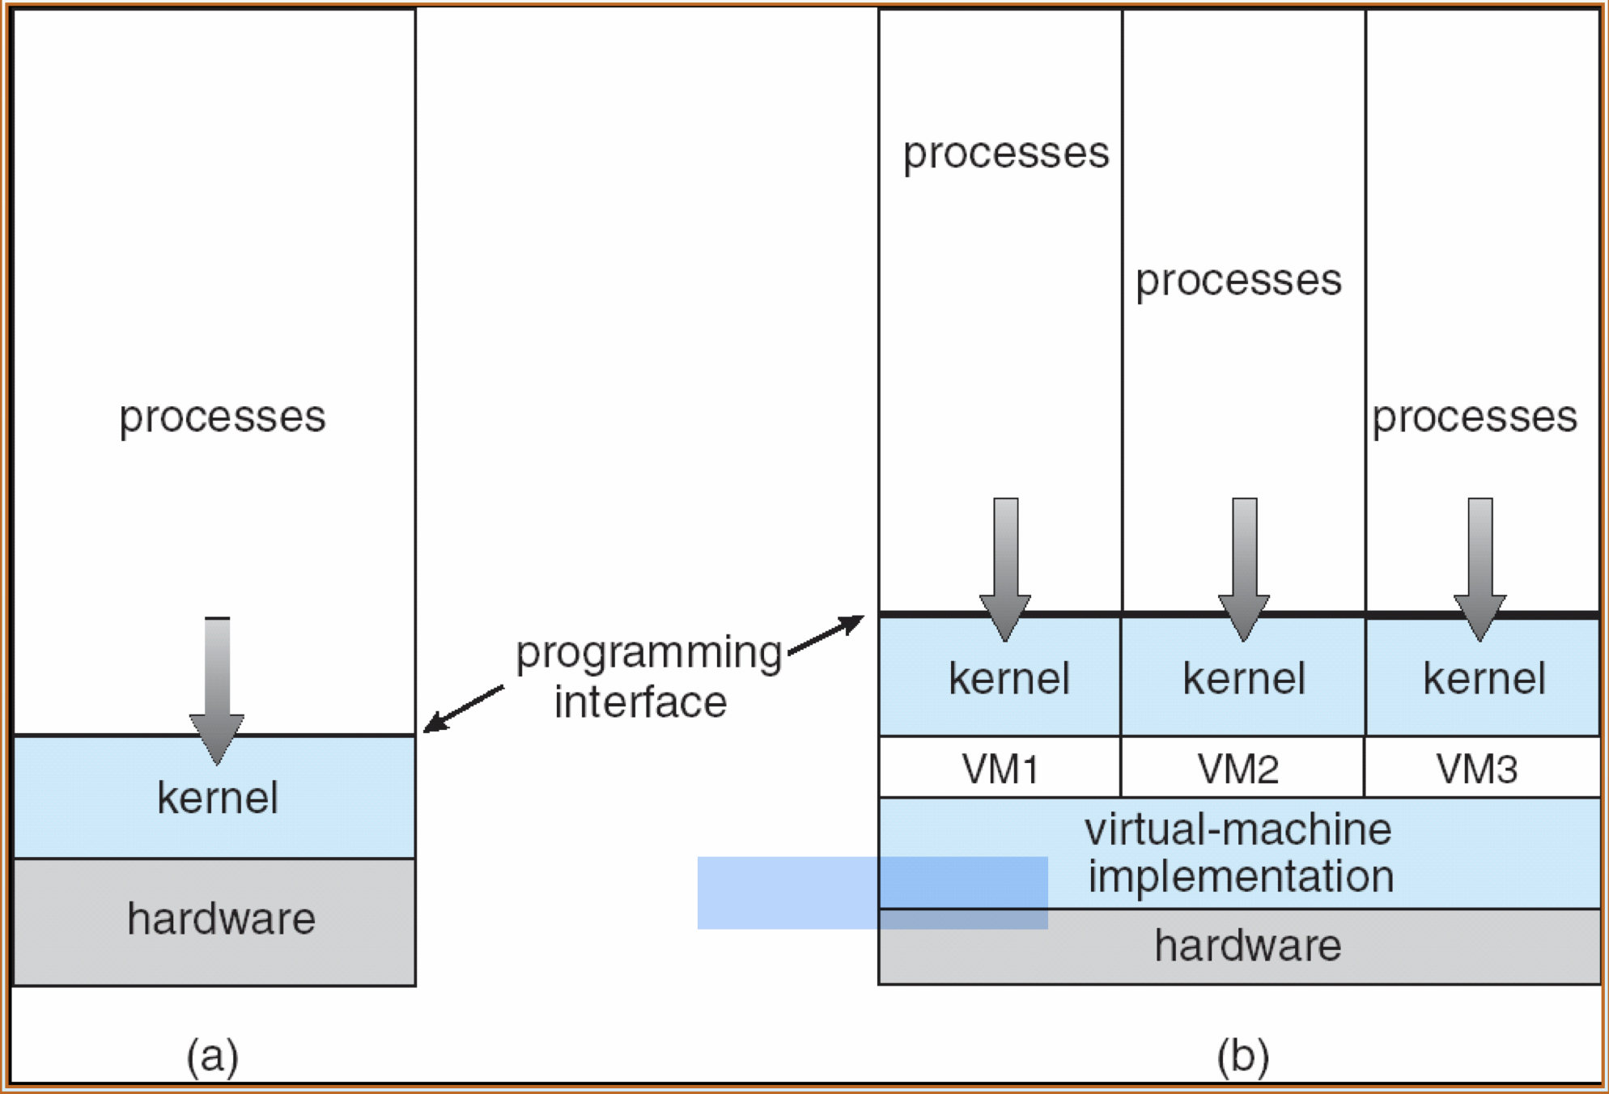
8.Virtual Machine Structure
In this kind of structure, hardware like CPU, memory, hard disks are abstracted into virtual machines.
Muliple virtual machines can be created on a single physical machine.
Advantages
High Customizable
Secure
Disadvantages
Less Performing
Complex designing
Examples: Linux

Slide 15
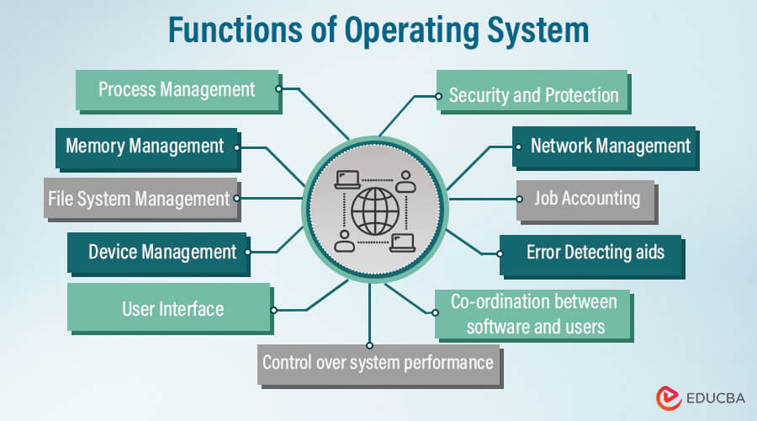
Functions/Goals of OS

Slide 16
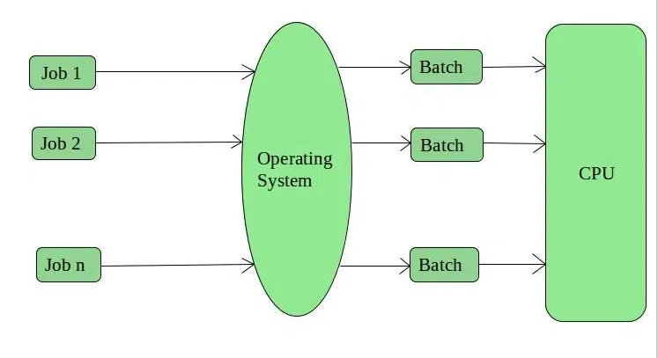
Types of OS
Batch Operating System
Multi-Programming System
Multi-Processing System
Multi-Tasking Operating System
Time-Sharing Operating System
Distributed Operating System
Network Operating System
Real-Time Operating System
Batch Operating System
Examples : Payroll Systems, Bank Statements, etc.

Slide 17
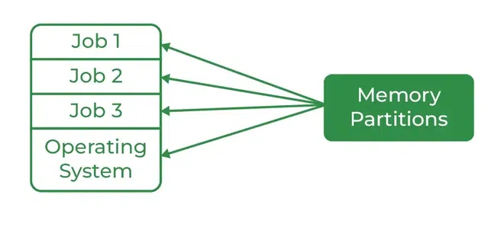
Multi-Programming OS
Examples : Windows,Mac OS etc

Slide 18
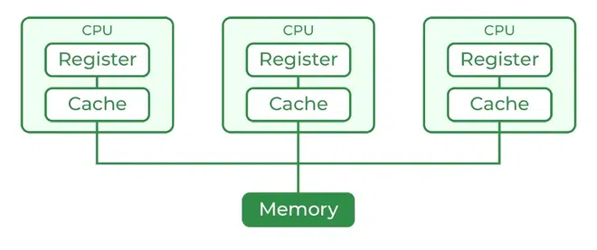
Multi-Processing OS
Examples : Windows,Mac OS etc

Slide 19
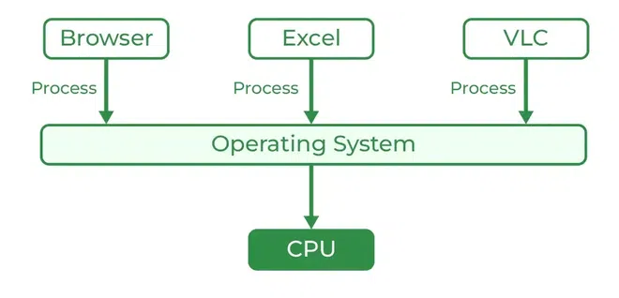
Multi-Tasking OS
Examples : Windows,Mac OS etc

Slide 20
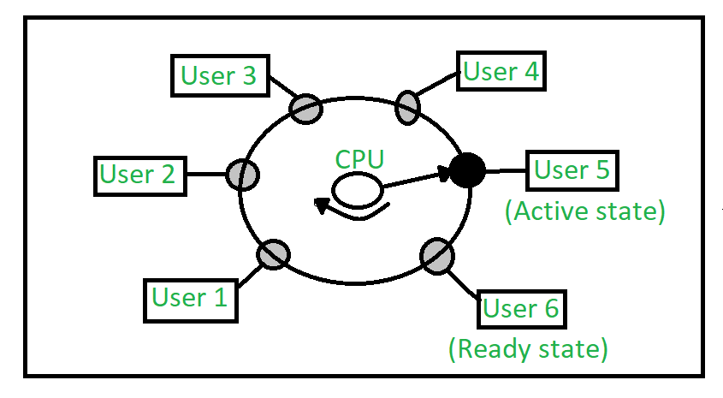
Time-Sharing OS
Examples : IBM VM/CMS,Windows Terminal Services

Slide 21
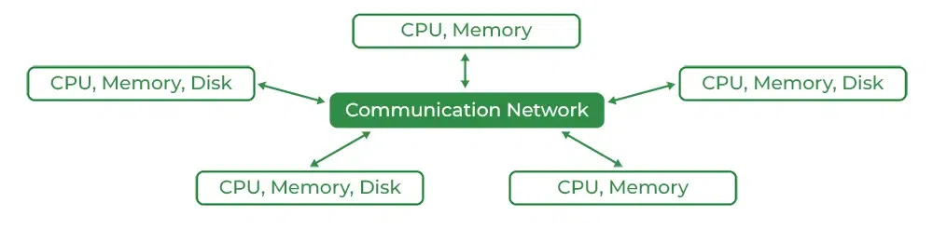
Distributed Operating System
Examples : Windows,Linux etc

Slide 22
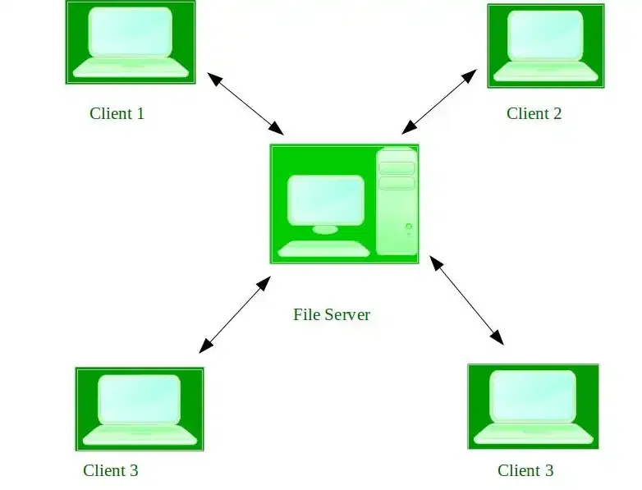
Network OS
Examples: Microsoft Windows Server ,UNIX, Linux, Mac OS Xetc.

Slide 23
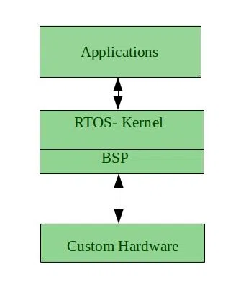
Real-Time Operating System
Examples : Scientific experiments, weapon systems, robots, air traffic control systems, etc.

Slide 24
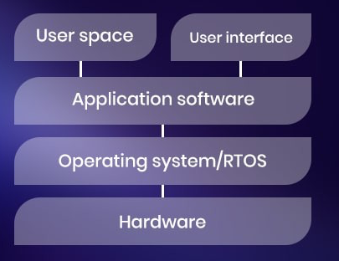
Embedded Operating System
Examples : QNX,FreeRTOS

Slide 25
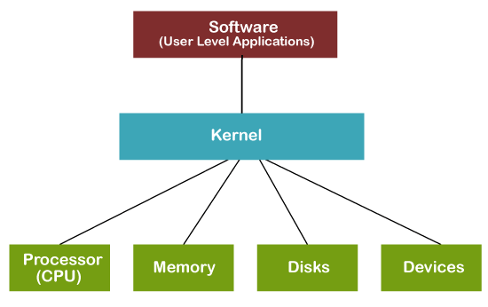
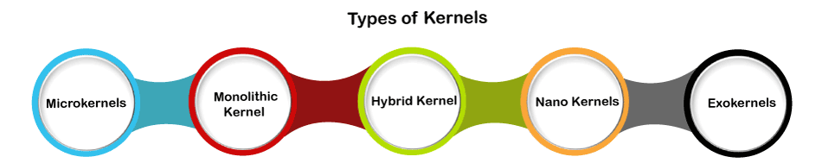
Kernel Data Structures, System Interface, System Calls
Kernel is a computer program that is a core or heart of an operating system.

Slide 26
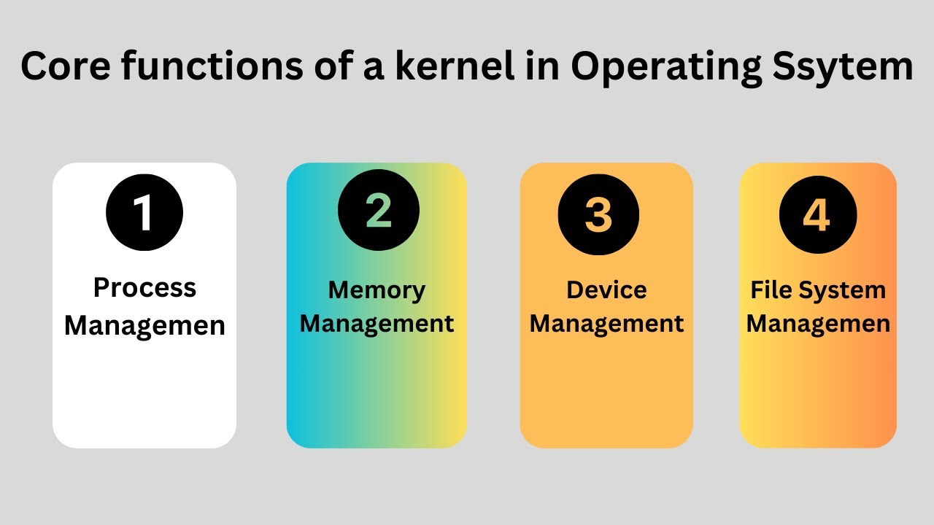

Slide 27
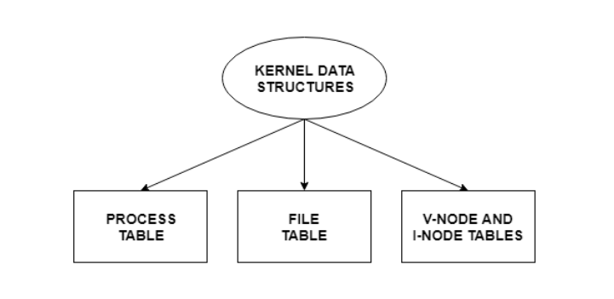
Kernel Data Structures
They store data about the current state of the system.
For example, if a new process is created in the system, a kernel data structure is created that contains the details about the process.
Process Table
Stores information about all the processes running in the system.
File Table
The file table contains entries about all the files in the system.
V-Node(Virtual Node) and I-Node(Index Node) Tables
Both the v-node and i-node are references to the storage system of the file and the storage mechanisms.
The v-node defines the method to access file data.
The i-node specifies file access information like file storage device, read/write procedures etc.

Slide 28
System Interface
Defines the mechanisms through which applications interact with the kernel.
It provides a well-defined set of functions and protocols that applications can use to request kernel services.
Key components of the system interface include:
System Calls: Functions that applications invoke to request kernel services.
Application Programming Interface (API): A set of libraries and functions that provide a higher-level abstraction of system calls.
Device Drivers: Provide a standardized interface for applications to interact with hardware devices.

Slide 29
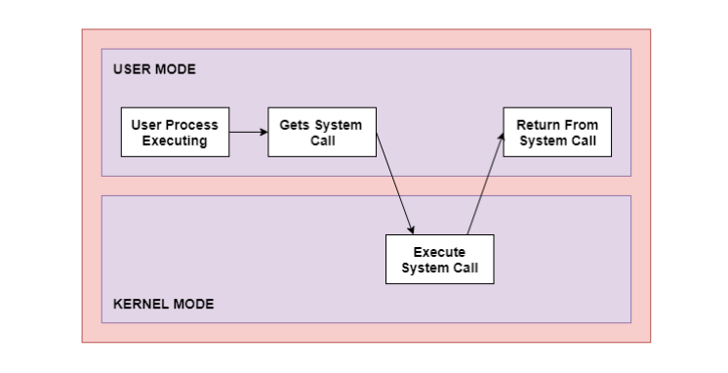
System Call
A system call is a mechanism used by programs to request services from the operating system (OS).
A system call is a way for programs to interact with the operating system
Fig: Representing the execution of the system call

Slide 30
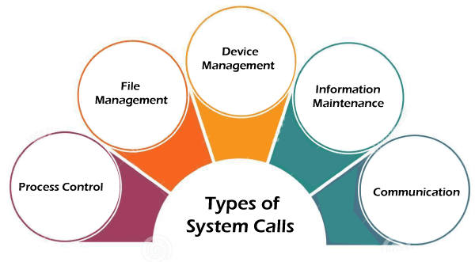

Slide 31
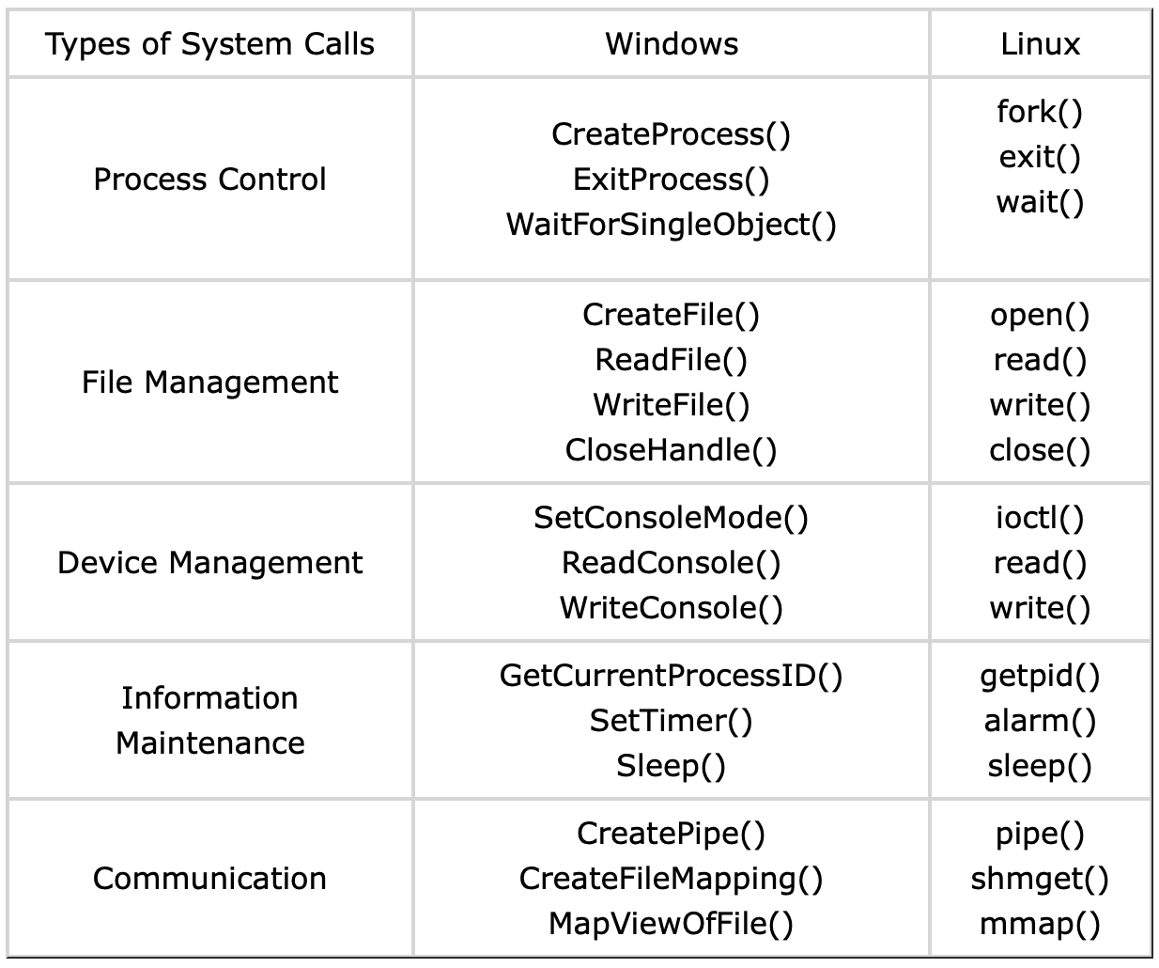

Slide 32
Need of system call
To create or delete a file.
To send and receive data packets.
To read or write a file
To access hardware devices, including a printer, scanner
To create and manage new processes.
Advantages of system call
Access to Hardware Resources:
Memory Management:
Process Management:
Security:
Standardization:
Disadvantages of System Call
Performance Overhead:
Security Risks:
Error Handling Complexity:
Compatibility Challenges:
Resource Consumption:

Slide 33
End of Unit

Slide 34
THANK YOU

